Slide 1
Power BI overview
Prepared by Ismail K
“BI is about providing the right data at the right time to the right people so that they can take the right decisions”

Slide 2
WHAT IS POWER BI?
Power BI: Power Bi is a business intelligence tool by Microsoft. It aims to provide interactive visualizations and business intelligence capabilities with a simple interface for end users to create their own reports and dashboards
Microsoft offers three types of Power BI platforms:
Power BI Desktop (A desktop application)
Power BI Service (SaaS i.e., Software as a Service)
Power BI Mobile (For iOS and Android devices)

Slide 3
WHY POWER BI?
Connect, transform and analyze millions of rows of data
API’s for integration.
Data Analysis Expressions (DAX).
Mobility
Machine learning
Low Cost

Slide 4
ROLE OF POWER BI IN HEALTH CARE
With a Power BI dashboard, one can monitor hospital and healthcare quality indicators such as:
Clinical Dashboard
Nursing unit
Patients in emergency room
Hospital Dashboard
Admissions
Emergency room waiting times
Quaterly income
Physcian Dashboard
Number of patients
Patinet satisifaction
Number of new patients
Patient Dashboard
Average length of stay
Total n.of patients
Lab waiting time

Slide 5
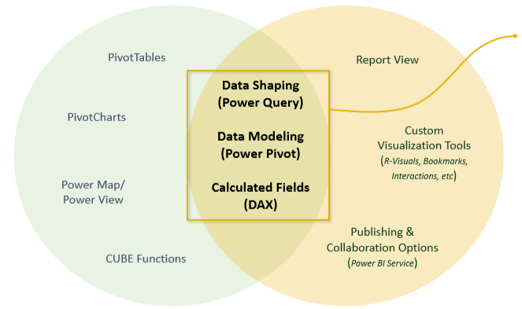
POWER EXCEL VS POWER BI?
Power Excel
Power Bi
“Power Excel” and Power BI are built on top of the exact same engine!
Power BI takes the same data shaping, modelling and analytics capabilities and adds new reporting and publishing tools
Transitioning is easy; you can import an entire data model directly from Excel!

Slide 6
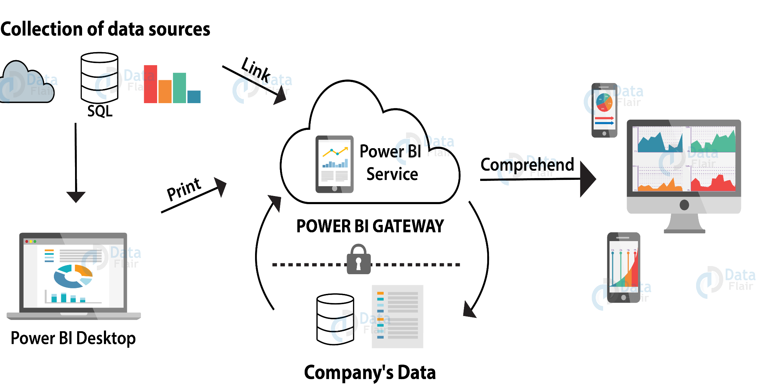
PROCESS FLOW OF POWER BI

Slide 7
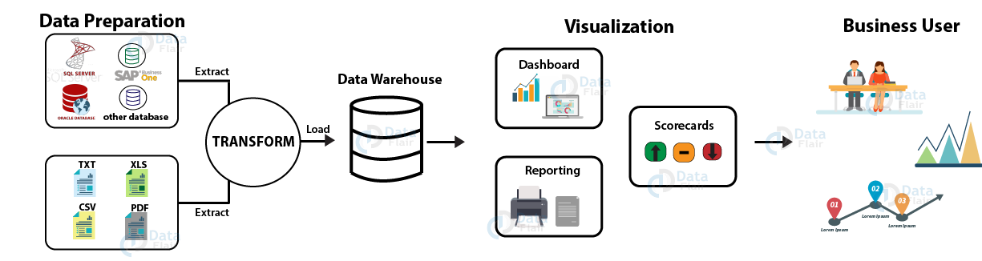
POWER BI ARCHITECTURE

Slide 8
STEPS IN POWER BI ARCHITECTURE
1. Data Integration: (Data Preparation)
In Power BI, we can import data from different kinds of data sources in different formats. It is stored in a common storage area known as the staging area.
2. Data Processing: (Data Warehouse)
Several processing or cleansing operations transform the raw data such as removing redundant values, etc.
3. Data Presentation: (Visualization)
The data moves from the warehouse and goes into the Power BI platforms like Power BI Desktop to create reports, dashboards.

Slide 9
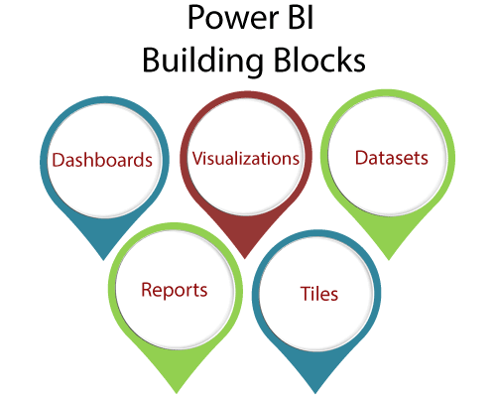
POWER BI BUILDING BLOCKS
Visualization
Reports
Dashboards
Datasets
Tiles

Slide 10
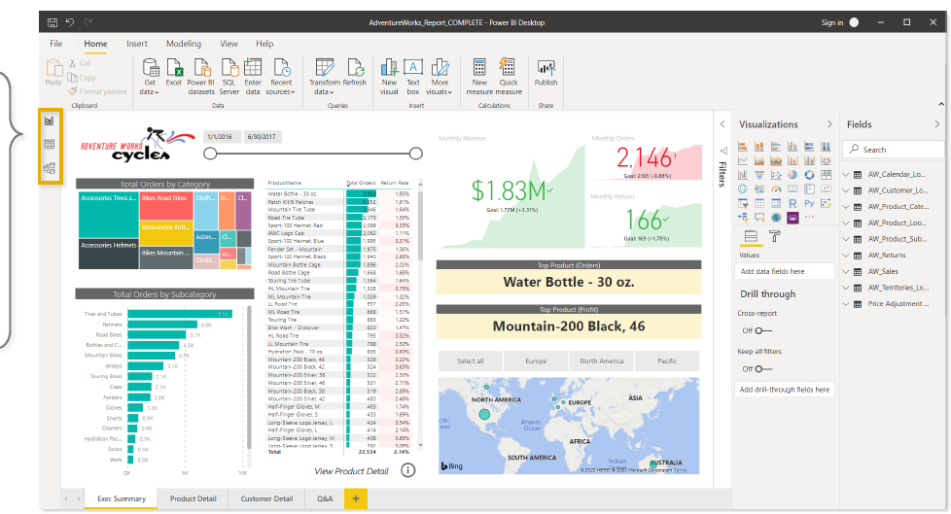
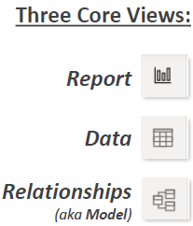
POWER BI INTERFACE

Slide 11
THREE CORE VIEWS IN POWERBI
Report view : Report view tab is used for building and viewing reports based on the datasets defined in Data view
Data view : Data view is used to define datasets based on data retrieved from one or more data sources
Relationships view : It is used to identify relationships between the datasets defined in Data view. When possible, Power BI Desktop identifies the relationships automatically, but you can also define them manually.

Slide 12
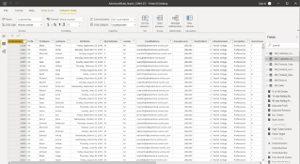
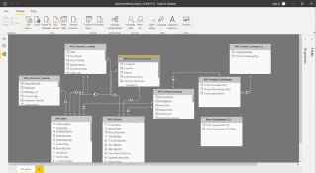
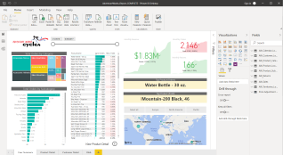



POWER BI WORK FLOW
Connect, shape and
transform raw data
Build table relationships
To create a data model
Design interactive reports
to explore and visualize data

Slide 13
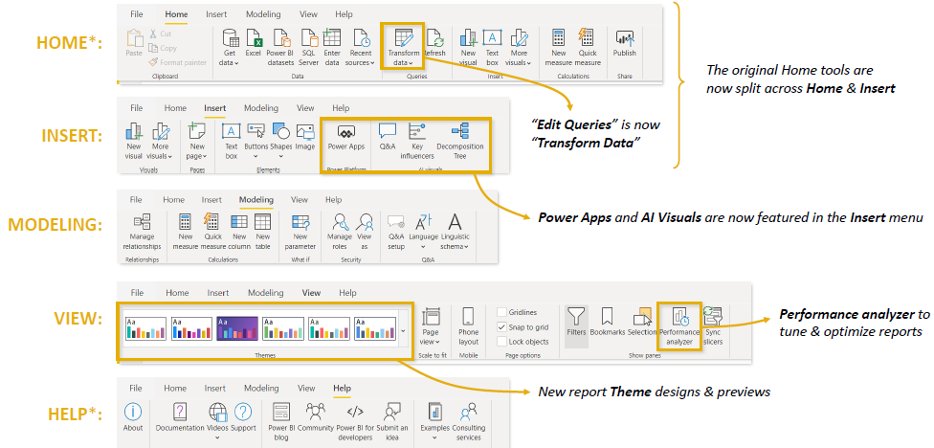
REPORT VIEW TAB

Slide 14
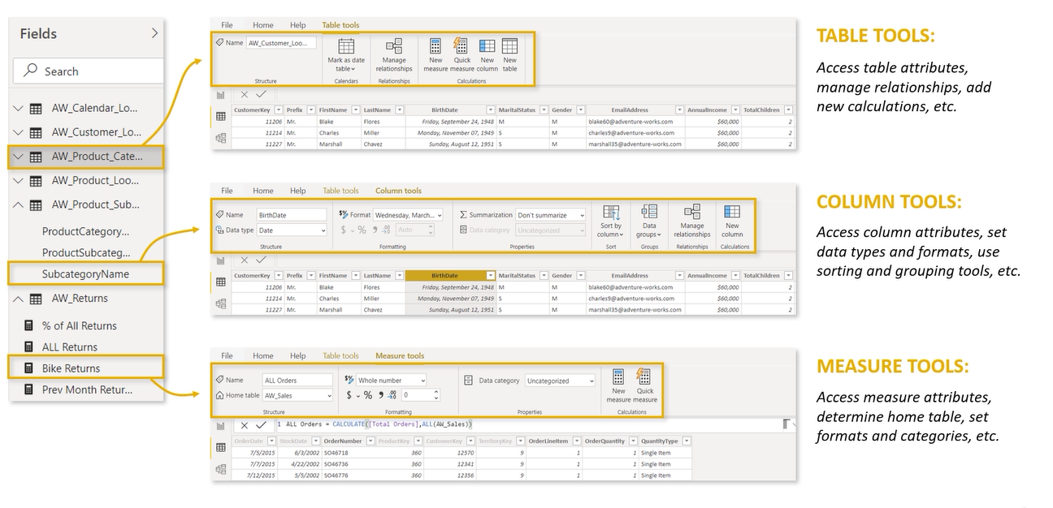
DATA VIEW TAB

Slide 15
CONNECTING
&
SHAPING DATA

Slide 16
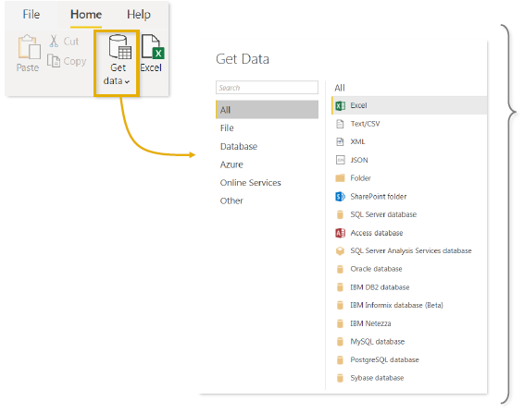
TYPES OF DATA CONNECTORS
Power BI can connect to virtually any type of source data, including (but not limited to):
•Flat files & Folders (csv, text, xls, etc)
•Databases(SQL, Access, Oracle, IBM, Azure, etc)
•Online Services(Sharepoint, GitHub, Dynamics 365, Google Analytics, Salesforce, Power BI Service, etc)
•Others(Web feeds, R scripts, Spark, Hadoop, etc)

Slide 17
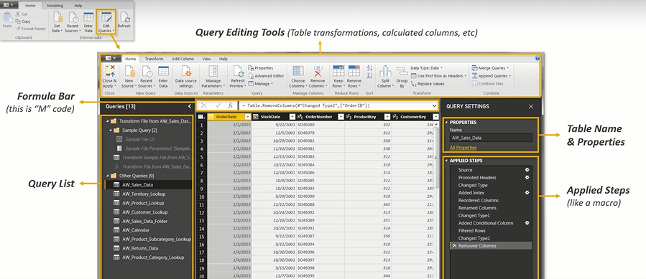
POWER QUERY EDITOR

Slide 18
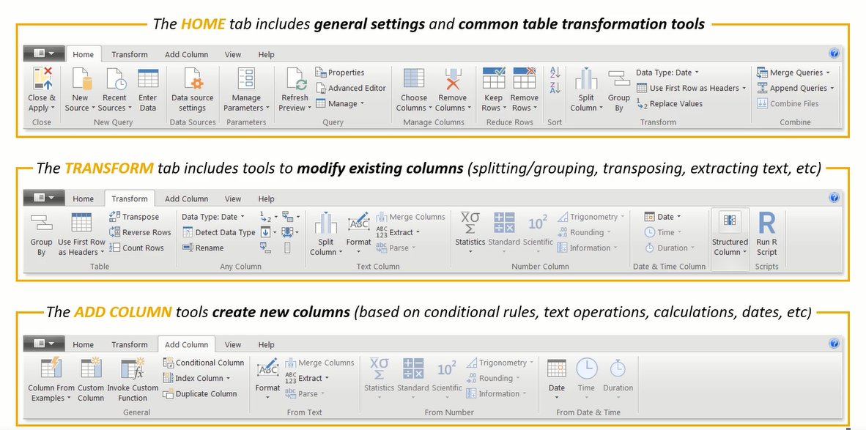
QUERY EDITING TOOLS

Slide 19
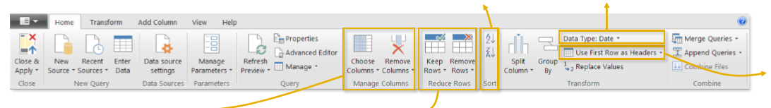
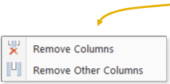
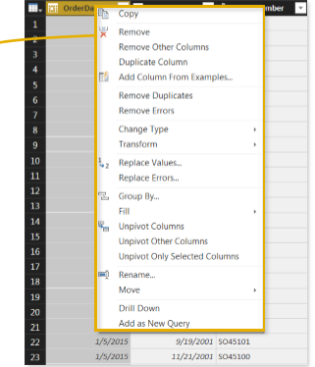
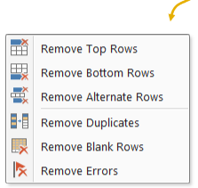
BASIC TABLE TRANSFORMATION
Sort values (A-Z, Low-High, etc.)
Change data type (date, $, %, text,etc.)
Promote header row
Duplicate,
move & rename columns Tip: Right-click the column header to Access
common tools
Choose or remove columns
Tip: use the “Remove Other Columns” option if you always want a specific set
Keep or remove rows
Tip: use the “Remove Duplicates” option to create a new lookup table from scratch

Slide 20
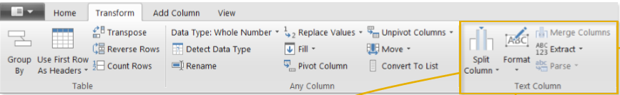
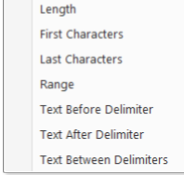
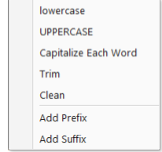

TEXT SPECIFIC TOOLS
Split a text column based on either a specific delimiter or a number of characters
Extract characters from a text column based on fixed lengths, first/last, ranges or delimiters
Note: Select two or more columns to merge (or concatenate) fields
Format a text column to upper, lower or proper case, or add a prefix or suffix
IMPORTANT NOTE! We can access many of these tools in both the “Transform” and “Add Column” menus -- the difference is whether you want to add a new column or modify an existing one

Slide 21
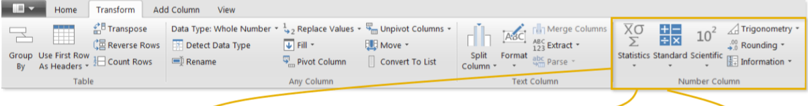
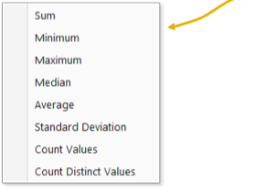
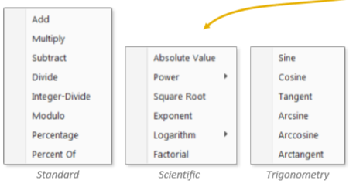
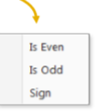
NUMBER SPECIFIC TOOLS
Information tools allow you to define binary flags (TRUE/FALSE or 1/0) to mark each row in a column as even, odd, positive or negative
Statistics functions allow you to evaluate basic stats for the selected column (sum, min/max, average, etc.
Standard, Scientific and Trigonometry tools allow you to apply standard operations (addition, multiplication, division, etc.)

Slide 22
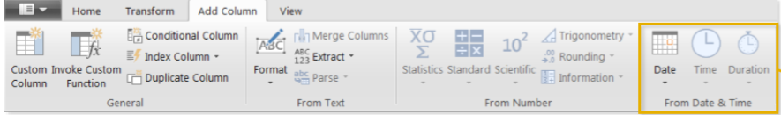
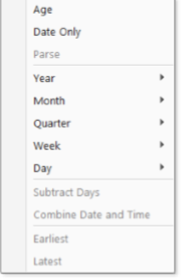
DATE SPECIFIC TOOLS
Date & Time tools are relatively straight-forward, and include the following options:
Age
Date Only
Year/Month/Quarter/Week/Day
Earliest/Latest
Note: We will always want to perform these operations from the “Add Column” menu to build out new fields, rather than transforming an individual date/time column

Slide 23
THANK YOU

Slide 24


